Slide 1
2013 RTS Campus Improvement Project
Project Overview
Project Status & Schedule
Schematic Design Overview
Questions

Slide 2
RTS Campus by the Numbers
Site historically used for transit since the 1890s
17 acres with 5.2 acres under roof
3 buildings constructed in 1974
254 buses (need parking for 300 buses)
604 employees; 24 hour a day operations (need parking for 412 cars)

Slide 3
Existing RTS Campus

Slide 4
Project Goals
Improve capacity and efficiency of maintenance and servicing operations at the RTS Campus
Improve vehicular and pedestrian safety
Adequate bus parking, maximizing garage parking
Adequate employee parking
Address infrastructure deficiencies
Minimize impact of late-night servicing
Minimize impact of early morning cold-weather bus starts
Minimize visual and noise impacts

Slide 5
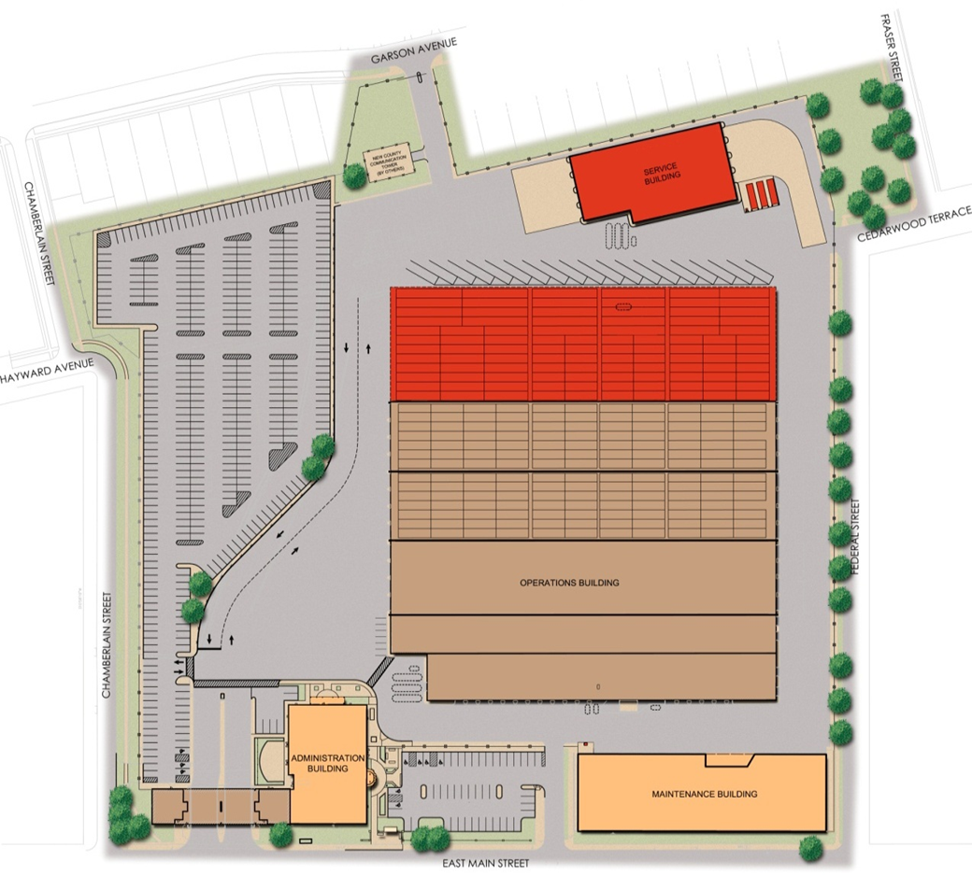
2013 RTS Campus Improvement Project
New/Expanded Service Building
Parking Lot
Garage “D” Addition
Replace Perimeter Wall
Property Acquisition
Operations Building Renovation
Site Infrastructure Improvements
Maintenance Warehouse
Tank Removals

Slide 6
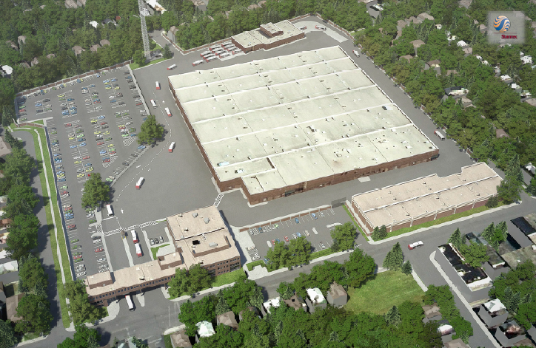
Perspective View

Slide 7
Acquisition Parcels

Slide 8
Current Status
Schematic Design (30%) Complete
Environmental Review Complete
Eminent Domain Hearing and Determination Complete
Beginning Appraisal Process
Beginning Design Builder Selection
Notes:
8

Slide 9
Project Schedule
Award Design Build Contract | May 2014
Final design Complete | August 2014
Start Construction | January 2015

Slide 10
Schematic Design Overview
Parking Lot
Chamberlain Perimeter Wall and Landscaping
Maintenance Warehouse Phases and Views

Slide 11
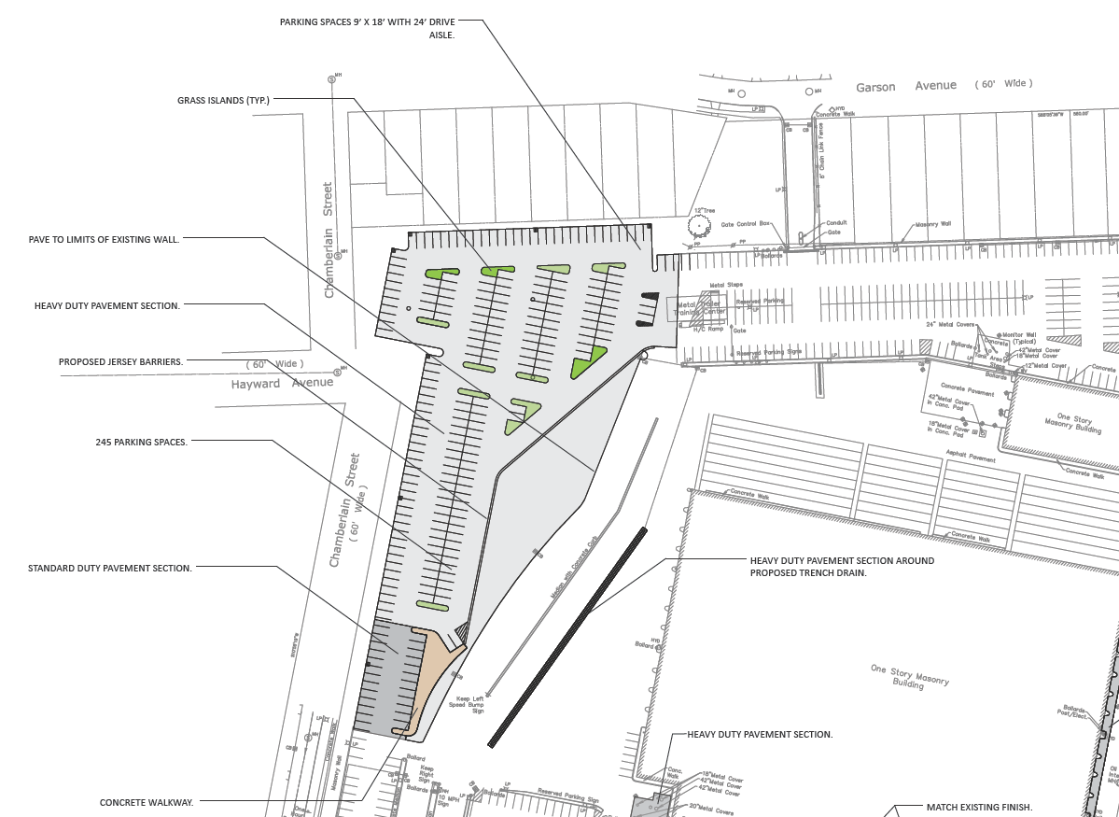
NEW PARKING LOT

Slide 12
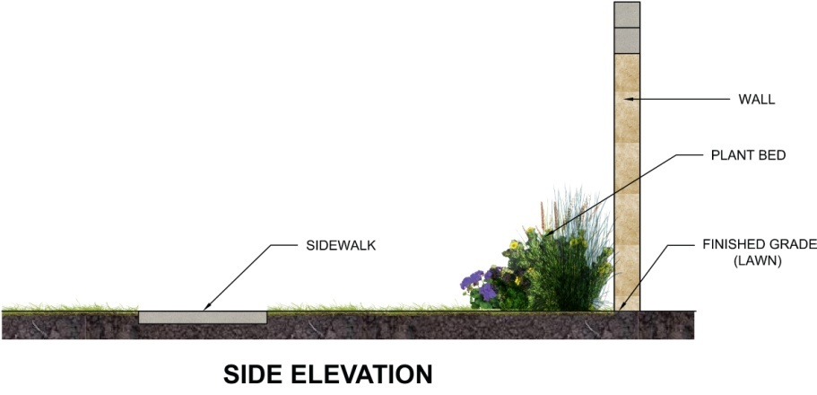
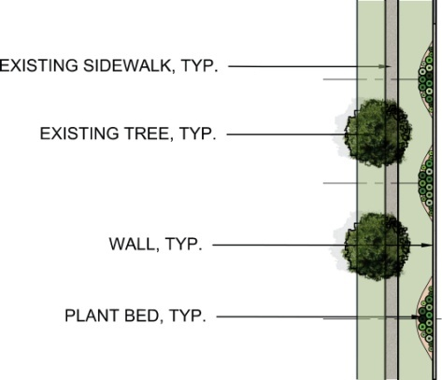
Perimeter Wall and Landscaping

Slide 13
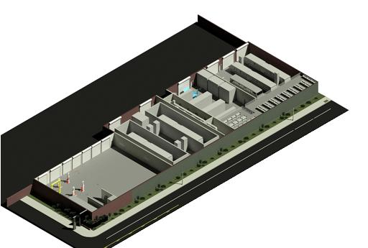
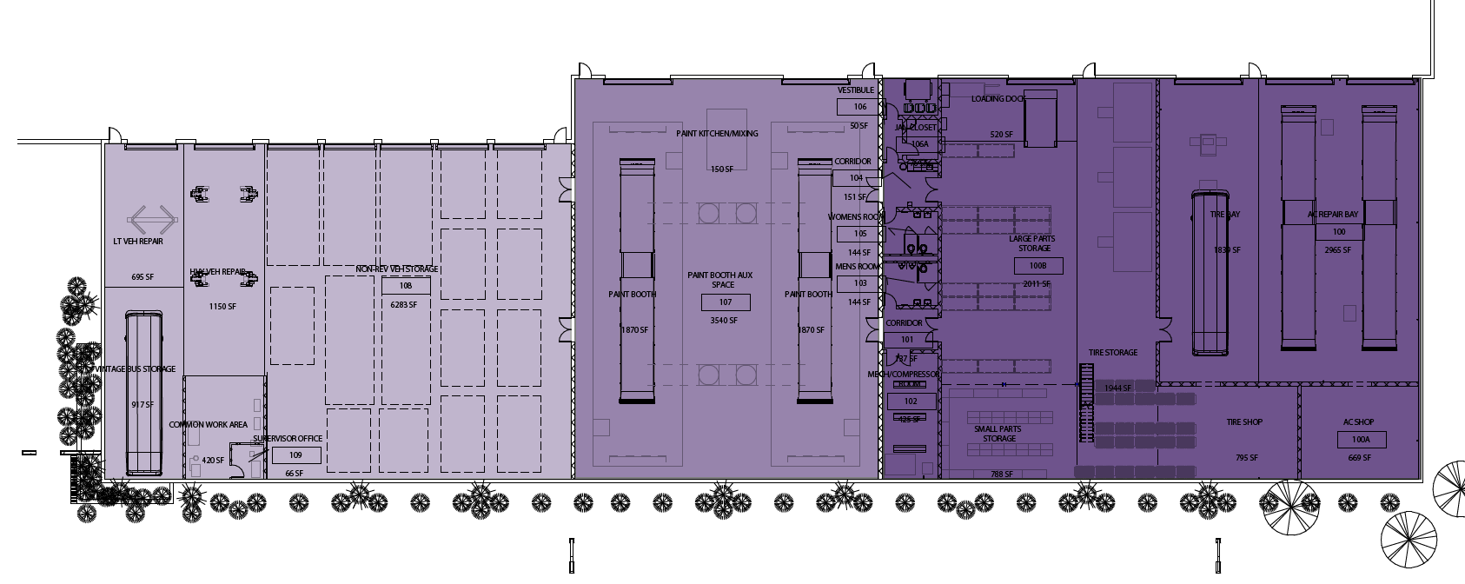
Maintenance Warehouse
PHASE III
PHASE II
PHASE I

Slide 14
Maintenance Warehouse Views from Main Street

Slide 15
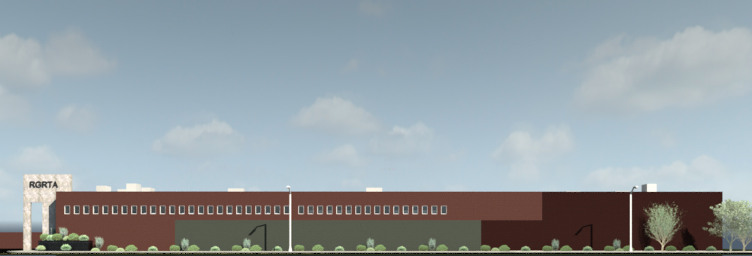

Slide 17
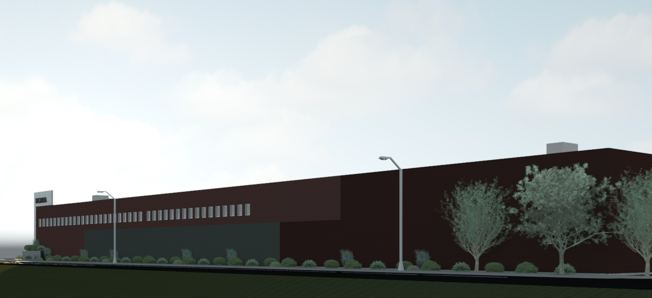

Slide 18
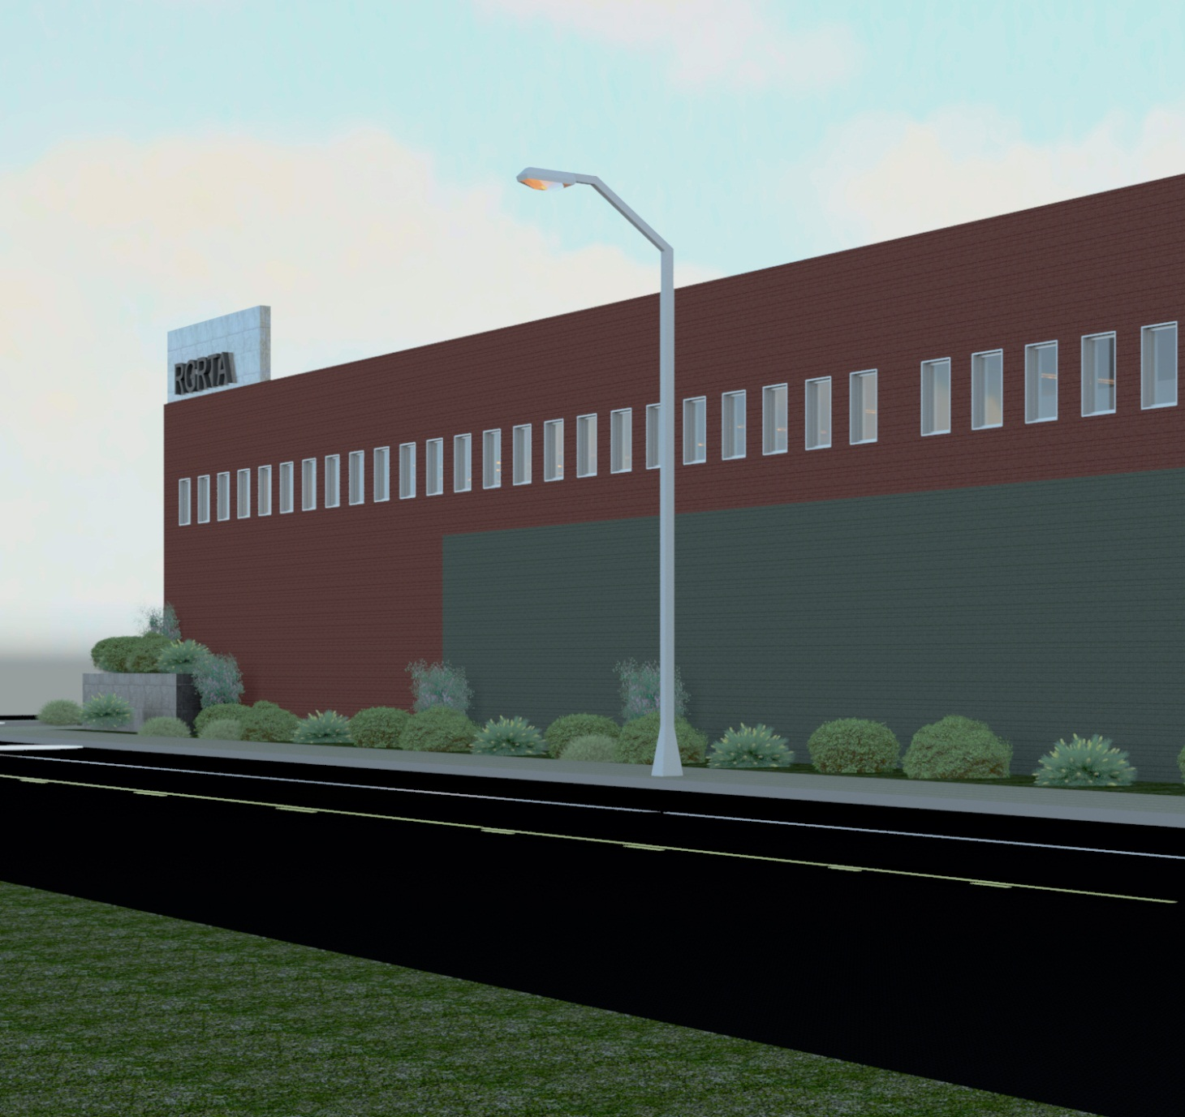

Slide 20
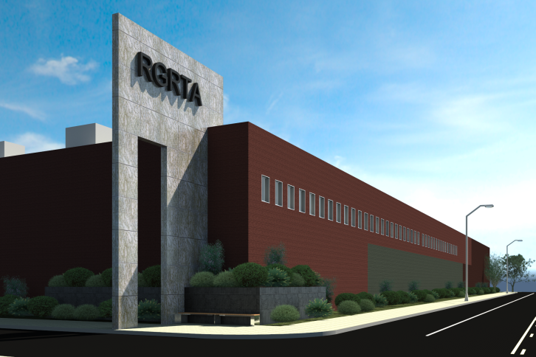
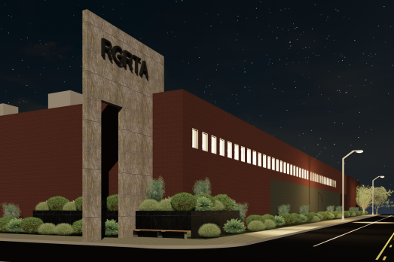

Slide 21
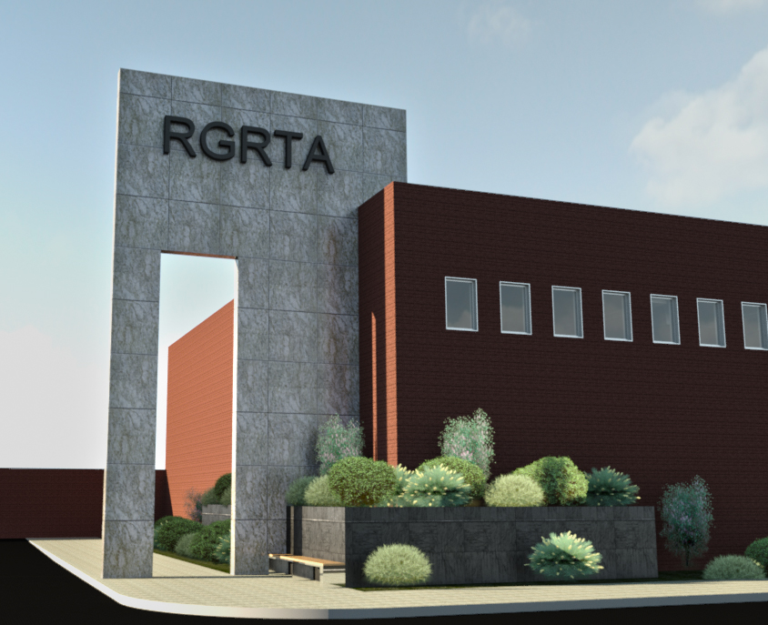

Slide 22
Questions?

